Slide 1
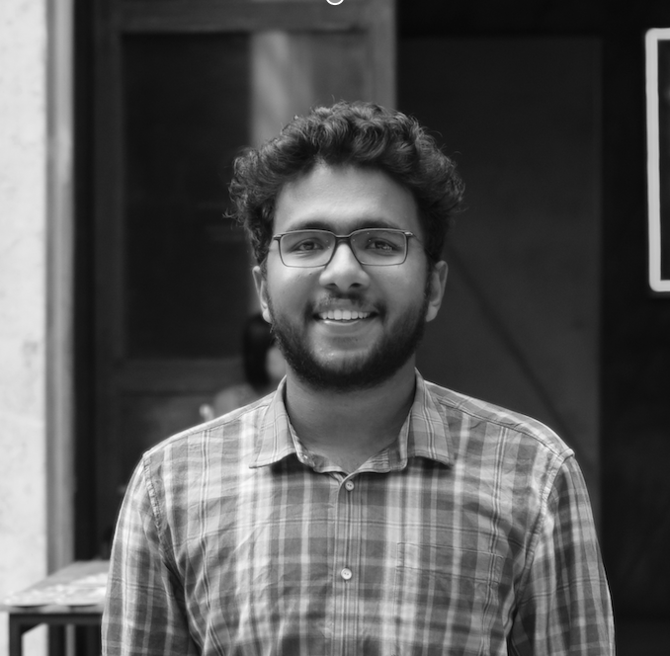
Using K-nearest-neighbors for Digit Recognition
Hrisheekesh R Senior Data Analyst, Attinad Software
www.attinadsoftware.com

Slide 2

Overview
Introduce the MNIST handwritten digit dataset
Understand the K-nearest-neighbors machine learning algorithm
Implement K-nearest-neighbors in TensorFlow to identify handwritten digits from 0 to 9

Slide 3
The MNIST Handwritten Digits Dataset

Slide 4

MNIST Dataset
Handwritten digits database
Large quantity of handwritten digits
commonly used for training image
processing systems

Slide 5
MNIST Dataset
Handwritten digits database
Modified National Institute of Standards
and Technology

Slide 6
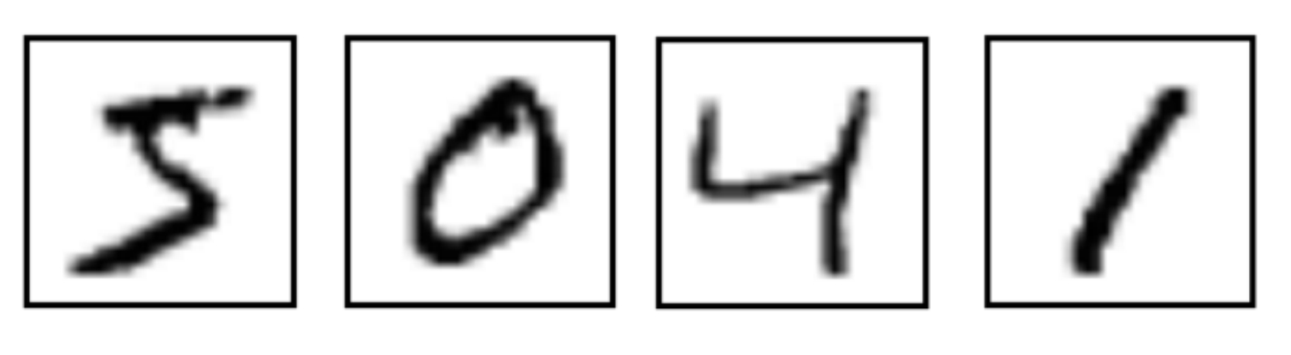
MNIST Dataset
Each digit is in grayscale

Slide 7
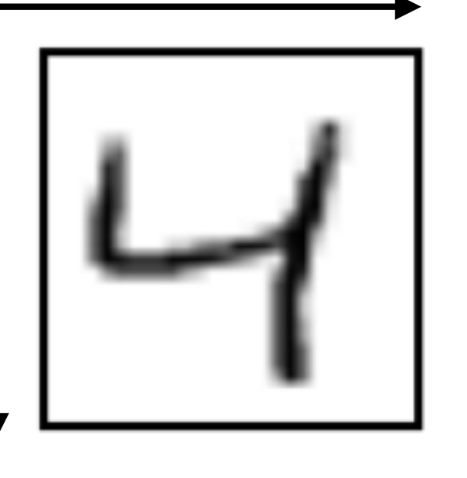
MNIST Dataset
Every image is
standardized to
be of size 28x28
= 784 pixels

Slide 8
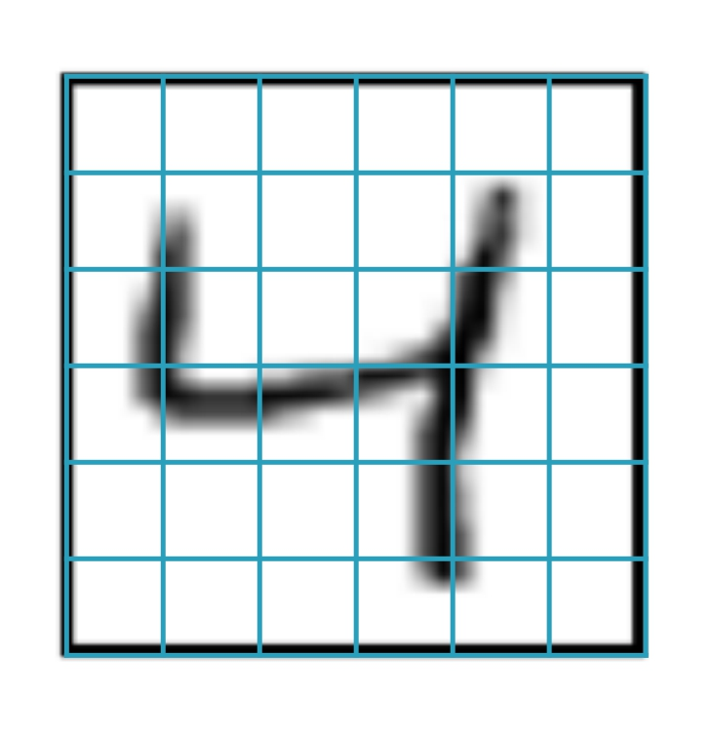
MNIST Dataset
Every pixel holds a single value for intensity

Slide 9
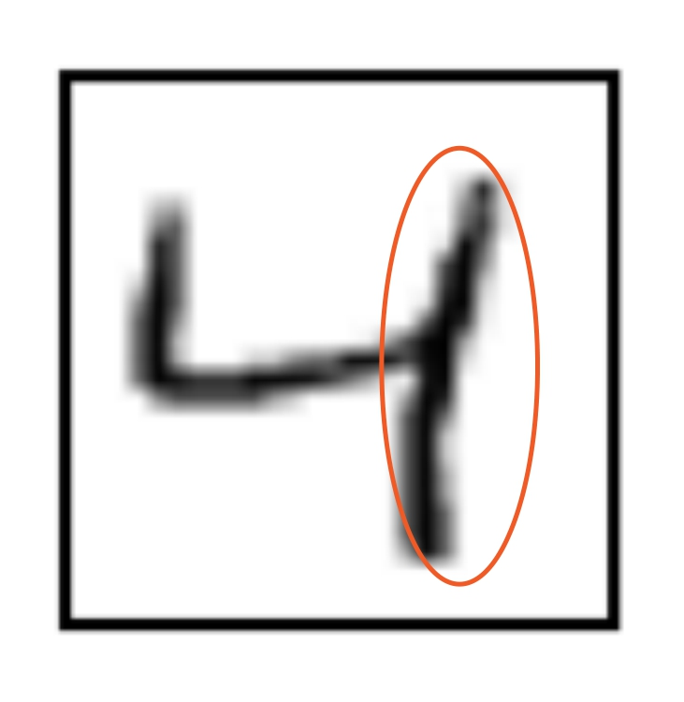
MNIST Dataset
0 0 0 0 0 0
0.2 0.8 0 0.3 0.6 0
0.2 0.9 0 0.3 0.8 0
0.3 0.8 0.7 0.8 0.9 0
0 0 0 0.2 0.8 0
0 0 0 0.2 0.2 0

Slide 10
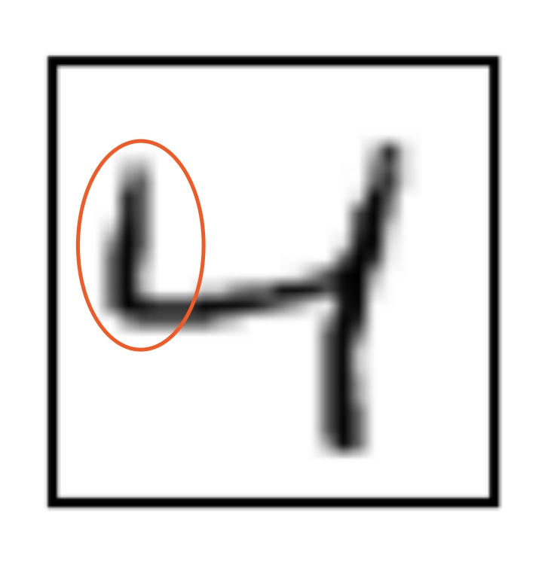
MNIST Dataset
0 0 0 0 0 0
0.2 0.8 0 0.3 0.6 0
0.2 0.9 0 0.3 0.8 0
0.3 0.8 0.7 0.8 0.9 0
0 0 0 0.2 0.8 0
0 0 0 0.2 0.2 0

Slide 11
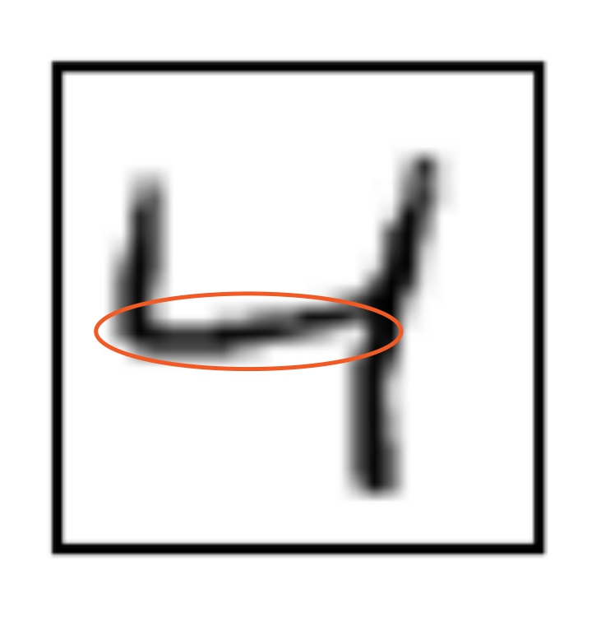
MNIST Dataset
0 0 0 0 0 0
0.2 0.8 0 0.3 0.6 0
0.2 0.9 0 0.3 0.8 0
0.3 0.8 0.7 0.8 0.9 0
0 0 0 0.2 0.8 0
0 0 0 0.2 0.2 0

Slide 12
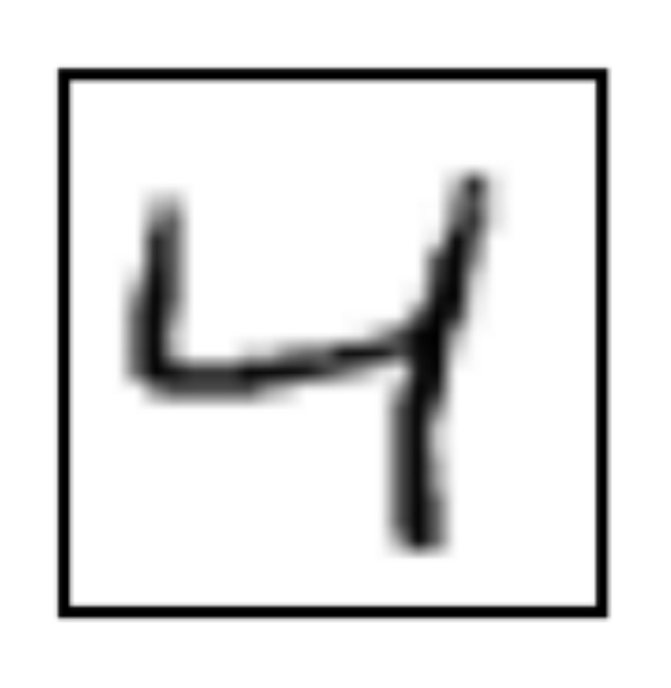
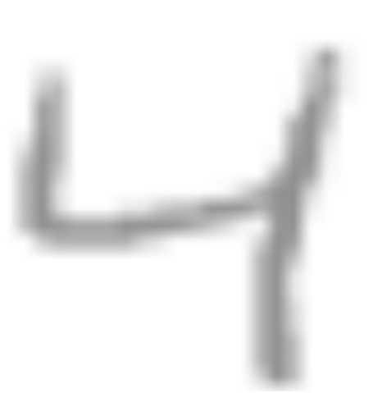
MNIST Dataset
0 | 0 | 0 | 0 | 0 | 0
0.2 | 0.8 | 0 | 0.3 | 0.6 | 0
0.2 | 0.9 | 0 | 0.3 | 0.8 | 0
0.3 | 0.8 | 0.7 | 0.8 | 0.9 | 0
0 | 0 | 0 | 0.2 | 0.8 | 0
0 | 0 | 0 | 0.2 | 0.2 | 0

Slide 13
MNIST Dataset
Every image has an associated label

Slide 14
MNIST Dataset
5 0 4 1

Slide 15
MNIST for machine learning is
the equivalent of the “Hello
World” for programming

Slide 16
The K-nearest-neighbors Algorithm

Slide 17


Types of ML Algorithms
Supervised
Labels associated with the training
data is used to correct the algorithm
Unsupervised
The model has to be set up right to
learn structure in the data

Slide 18

Supervised Learning
Input variable x and output variable y
Learn the mapping function y = f(x)
Approximate the mapping function so for new values of x we can predict y
Use existing dataset to correct our mapping function approximation

Slide 19

Unsupervised Learning
Only have input data x no output data
Model the underlying structure to learn more about data
Algorithms self discover the patterns and structure in the data

Slide 20


Training Data
ML-based Classifier
Breathes like a mammal
Gives birth like a
mammal
Mammal
Corpus

Slide 21
KNN is an supervised learning
algorithm which uses training
data to find what is most similar
to the current sample

Slide 22





K-nearest-neighbors
Uses the entire training
dataset as a model

Slide 23
K-nearest-neighbors
Rocket Buildings Signal Pig Shop
Each element in training
data has a label

Slide 24




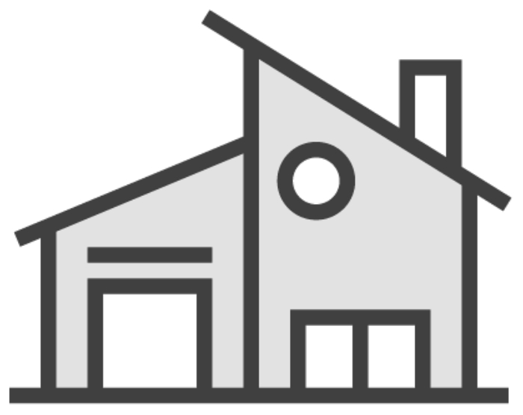
K-nearest-neighbors
Rocket Buildings Signal Pig Shop
Predictions for a new sample
involves figuring out which element
in the training data it is similar to
The nearest neighbor

Slide 25






K-nearest-neighbors
Rocket Buildings Signal Pig Shop

Slide 26



K-nearest-neighbors
Rocket Buildings Signal Pig Shop

Slide 27


K-nearest-neighbors
Rocket Buildings Signal Pig Shop

Slide 28



K-nearest-neighbors
Rocket Buildings Signal Pig Shop

Slide 29



K-nearest-neighbors
Rocket Buildings Signal Pig Shop

Slide 30


K-nearest-neighbors
How do we calculate neighbors of a
sample?

Slide 31
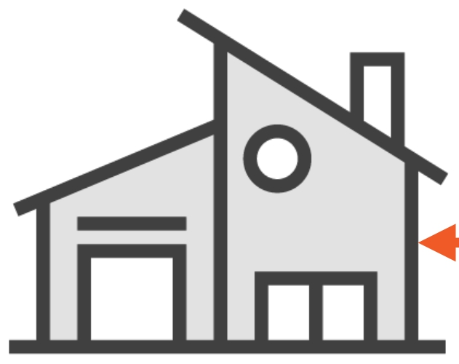

K-nearest-neighbors
Distance measures

Slide 32
K-nearest-neighbors
Euclidean distance, Hamming
distance, Manhattan distance

Slide 33
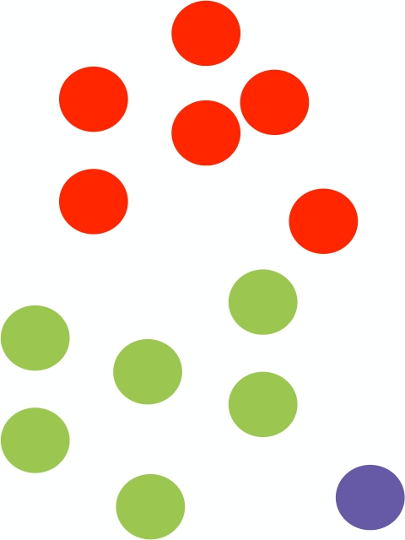
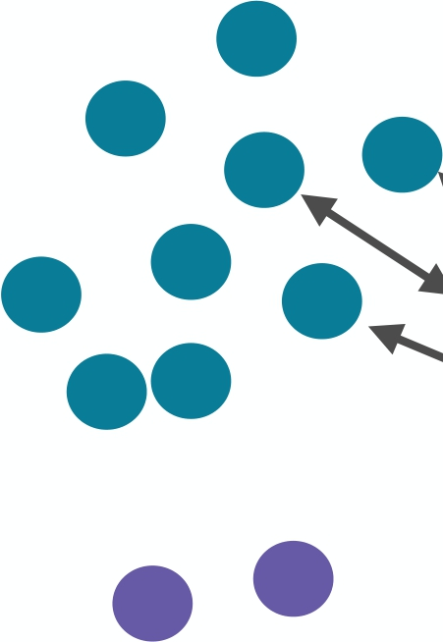



K-nearest-neighbors

Slide 34
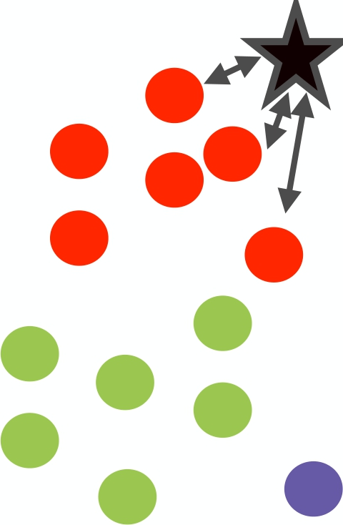


K-nearest-neighbors

Slide 35
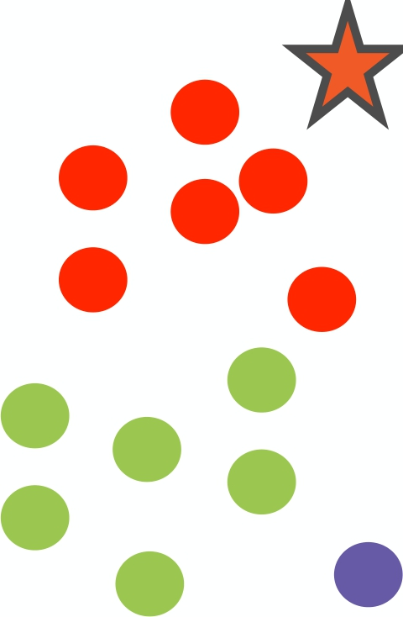
K-nearest-neighbors

Slide 36
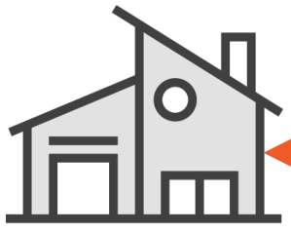
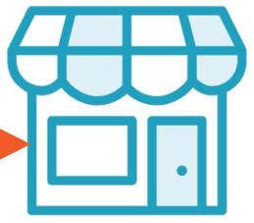
Distance Measures
EuclideanDistance(x, xi) = sqrt(sum((xj – xij)^2))

Slide 37
Distance Measures

Slide 38
Distance Measure
5 4 3 2 1
0
0 | 1 | 2 | 3 | 4 | 5
Euclidean Distance
As the crow flies

Slide 39
L1 Distance

Slide 40
Distance Measure
5 4 3 2 1
0
0 | 1 | 2 | 3 | 4 | 5
L1 distance
Snake distance
City block distance
Manhattan distance

Slide 41
L1 Distance
5, 4
5-1 = 4
5 4 3 2
0 | 1 | 2 | 3 | 4 | 5
1, 0
1
0

Slide 42
L1 Distance
5, 4
5-1 = 4
4-0 = 4
5 4 3 2
0 | 1 | 2 | 3 | 4 | 5
1, 0
1
0

Slide 43
L1 Distance
5, 4
5-1 = 4
4-0 = 4
5 4 3
0 | 1 | 2 | 3 | 4 | 5
= 8
2
1
0
1, 0

Slide 44

Handwritten image recognition using the k-nearest-neighbors ML algorithm
• Use the L1 distance measure to find
the nearest neighbor
• Measure the accuracy of the algorithm
on the test data
Demo

Slide 45




KNN Implemented in TensorFlow
Getting MNIST images
Access the MNIST training and test images in batches using the TensorFlow libraries
Running the algorithm
Predict labels for all the test data and measure accuracy
Calculating L1 distance
Find the distance between the test digit and all training digits

Slide 46
KNN Implemented in TensorFlow
Getting MNIST images
Access the MNIST training and test images in batches using the TensorFlow libraries

Slide 47
MNIST Dataset
5 0 4 1

Slide 48
MNIST Dataset
Every image is
standardized to
be of size 28x28
= 784 pixels
4

Slide 49

Representing Labels
4
Vector
Index
0
0
0
1
0
2
0
3
1
4
0
5
0
6
0
7
0
8
0
9

Slide 50
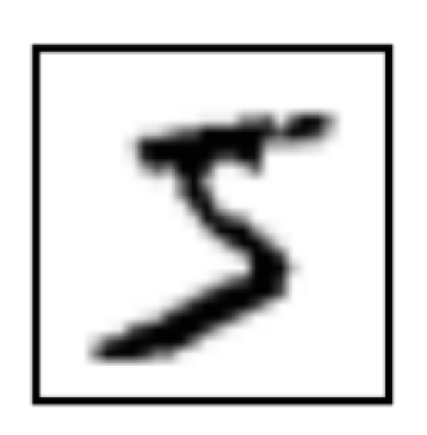
Representing Labels
5
Vector
Index
0
0
0
1
0
2
0
3
0
4
1
5
0
6
0
7
0
8
0
9
Notes:
Back to demo

Slide 51
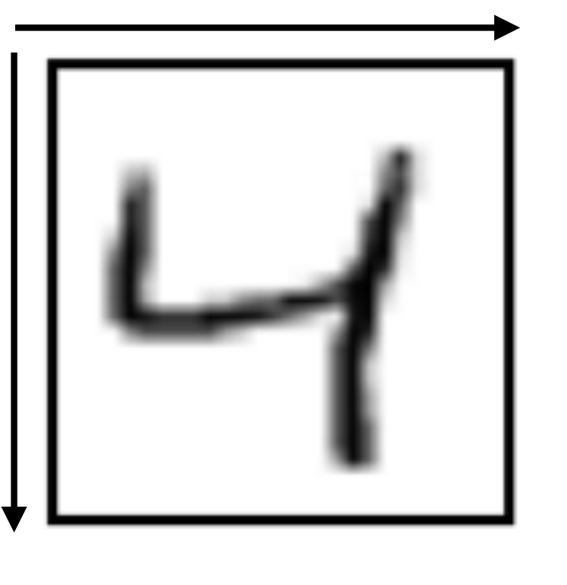
Representing Images
28
28
= 784 pixels

Slide 52

Representing Images
= 784 pixels
0 | 0 | 0 | 0 | 0 | 0
0.2 | 0.8 | 0 | 0.3 | 0.6 | 0
0.2 | 0.9 | 0 | 0.3 | 0.8 | 0
0.3 | 0.8 | 0.7 | 0.8 | 0.9 | 0
0 | 0 | 0 | 0.2 | 0.8 | 0
0 | 0 | 0 | 0.2 | 0.2 | 0

Slide 53
Representing Images
0 | 0 | 0 | 0 | 0 | 0
0.2 | 0.8 | 0 | 0.3 | 0.6 | 0
0.2 | 0.9 | 0 | 0.3 | 0.8 | 0
0.3 | 0.8 | 0.7 | 0.8 | 0.9 | 0
0 | 0 | 0 | 0.2 | 0.8 | 0
0 | 0 | 0 | 0.2 | 0.2 | 0

Slide 54
Representing Images
0 0 0 0 0 0
0 | 0 | 0 | 0 | 0 | 0
0.2 | 0.8 | 0 | 0.3 | 0.6 | 0
0.2 | 0.9 | 0 | 0.3 | 0.8 | 0
0.3 | 0.8 | 0.7 | 0.8 | 0.9 | 0
0 | 0 | 0 | 0.2 | 0.8 | 0
0 | 0 | 0 | 0.2 | 0.2 | 0

Slide 55
Representing Images
0 0 0 0 0 0 0.2 0.8 0 0.3 0.6 0
0 | 0 | 0 | 0 | 0 | 0
0.2 | 0.8 | 0 | 0.3 | 0.6 | 0
0.2 | 0.9 | 0 | 0.3 | 0.8 | 0
0.3 | 0.8 | 0.7 | 0.8 | 0.9 | 0
0 | 0 | 0 | 0.2 | 0.8 | 0
0 | 0 | 0 | 0.2 | 0.2 | 0

Slide 56
Representing Images
0 0 0 0 0 0 0.2 0.8 0 0.3 0.6 0 0.2 0.9 0 0.3 0.8 0
0 | 0 | 0 | 0 | 0 | 0
0.2 | 0.8 | 0 | 0.3 | 0.6 | 0
0.2 | 0.9 | 0 | 0.3 | 0.8 | 0
0.3 | 0.8 | 0.7 | 0.8 | 0.9 | 0
0 | 0 | 0 | 0.2 | 0.8 | 0
0 | 0 | 0 | 0.2 | 0.2 | 0

Slide 57
Representing Images
 | 0 | 0 | 0 | 0 | 0 | 0 |  | .. | .. | .. | .. | .. | .. | 0 | 0 | 0 | 0.2 | 0.2 | 0
0 0 0 0 0 0
0.2 0.8 0 0.3 0.6 0
0.2 0.9 0 0.3 0.8 0
0.3 0.8 0.7 0.8 0.9 0
0 0 0 0.2 0.8 0
0 0 0 0.2 0.2 0

Slide 58
Representing Images
0 | 0 | 0 | 0 | 0 | 0 |  | .. | .. | .. | .. | .. | .. |  | 0 | 0 | 0 | 0.2 | 0.2 | 0
 | 0 | 0 | 0 | 0 | 0 | 0
 | 0.2 | 0.8 | 0 | 0.3 | 0.6 | 0
 | 0.2 | 0.9 | 0 | 0.3 | 0.8 | 0
 | 0.3 | 0.8 | 0.7 | 0.8 | 0.9 | 0
 | 0 | 0 | 0 | 0.2 | 0.8 | 0
 | 0 | 0 | 0 | 0.2 | 0.2 | 0

Slide 59
Representing Images
0 | 0 | 0 | 0 | 0 | 0 | .. | .. | .. | .. | .. | .. |  | 0 | 0 | 0 | 0.2 | 0.2 | 0
 | 0 | 0 | 0 | 0 | 0 | 0
 | 0.2 | 0.8 | 0 | 0.3 | 0.6 | 0
 | 0.2 | 0.9 | 0 | 0.3 | 0.8 | 0
 | 0.3 | 0.8 | 0.7 | 0.8 | 0.9 | 0
 | 0 | 0 | 0 | 0.2 | 0.8 | 0
 | 0 | 0 | 0 | 0.2 | 0.2 | 0

Slide 60
Representing Images
0 0 0 0 0 0 .. .. .. .. .. .. 0 0 0 0.2 0.2 0
= 784 pixels

Slide 61
KNN Implemented in TensorFlow
Getting MNIST images
Access the MNIST training and test images in batches using the TensorFlow libraries
Calculating L1 distance
Find the distance between the test digit and all training digits

Slide 62
L1 Distance
Training Test
0.2 0.8 0 0.3 0.6 0 0 0.6 0.2 0.3 0.3 0.1
tf.negative()
0.2 0.8 0 0.3 0.6 0 0 -0.6 -0.2 -0.3 -0.3 -0.1
tf.add()
0.2 0.2 -0.2 0 0.3 -0.1

Slide 63
L1 Distance
tf.add() tf.add() tf.add()
0.2 0.2 -0.2 0 0.3 -0.1 0 0.2 0.3 0.6 -0.3 -0.1 -0.2 0.4 -0.2 0 -0.3 -0.1
tf.abs() tf.abs() tf.abs()
0.2 0.2 0.2 0 0.3 0.1 0 0.2 0.3 0.6 0.3 0.1 0.2 0.4 0.2 0 0.3 0.1
tf.reduce_sum()
1.0
tf.reduce_sum()
1.5
tf.reduce_sum()
1.2

Slide 64
L1 Distance
tf.reduce_sum()
1.0
tf.reduce_sum()
1.5
tf.reduce_sum()
1.2
index = 0

Slide 65
KNN Implemented in TensorFlow
Getting MNIST images
Access the MNIST training and test images in batches using the TensorFlow libraries
Running the algorithm
Predict labels for all the test data and measure accuracy
Calculating L1 distance
Find the distance between the test digit and all training digits

Slide 66
Representing Labels
4
0 0 0 0 1 0 0 0 0 0
0 1 2 3 4 5 6 7 8 9
np.argmax()

Slide 67
Summary
Familiar with the MNIST handwritten digit dataset
Understood the logic behind the K- nearest-neighbors algorithm
Implemented K-nearest-neighbors using L1 distance to identify handwritten digits from 0 to 9

